Slide 1


Impact of Science Conference the Parallel Session on:
Enhancing Inclusive Economic Growth
23rd June, 2021

Slide 2


Impact of Science
23-25 June, 2021
Overview of the Speakers
John Crowley (Chair): Chief of Section for Research, Policy, and Foresight, UNESCO, France
Haroon Bhorat: Director of Development Policy Research Unit at University of Cape Town, South Africa
Erika Kraemer-Mbula : Professor of Economics at University of Johannesburg, South Africa
#IOS21

Slide 3
Impact of Science
23-25 June, 2021
Haroon Bhorat
Director of Development Policy Research Unit at University of Cape Town, South Africa
#IOS21

Slide 4


Enhancing Inclusive Economic Growth:
How Can Science Be Utilised for all of Society to Close Existing Inequality Gaps?
AESIS 2021 Virtual Conference:
The Transformative Power of Research
Haroon Bhorat
Professor of Economics
School of Economics, University of Cape Town
haroon.bhorat@uct.ac.za

Slide 5
Outline
Analytical Tools For Inclusive Economic Growth
  Inclusive Economic Growth: A Simple Mental Model
  Measures of Poverty and Inequality
  The Growth Incidence Curve
Applications of Measurement to South Africa
  Poverty and Inequality Outcomes in Post-Apartheid South Africa
  Second-Order Outcomes: Unequal Growth
  New Evidence: The Rise of the Missing Middle
The Policy Impact
  Using Research for Policy Impact: The Covid-19 SRD Grant
  The Next Research-Policy Frontier: Inequality and Joblessness
Post-Script: A UCT-Cornell University Research Innovation

Slide 6
Inclusive Economic Growth:
A Simple Mental Model
Country A distribution at time t: A= (1,2,3,4)
  GDP=10; If the poverty line, z=2.5 – then the incidence of poverty (H)=50%
Growth Occurs, and the following is the new distribution: A_{t+1} = (2,4,6,8)
  GDP=20; If the poverty line z=2.5, – then the incidence of poverty (H) =25%
Now consider the following:
Country A distribution at time t: A= (1,2,3,4)
  GDP=10; If z=2.5, H=50%
BUT what if A_{t+1} = A_{(t+1)’} =(1,2,5,12)
  GDP=20; If z=2.5, H=50%
This is the core of thinking about growth, poverty and inequality interactions and goes to the heart of our understanding of inclusive economic growth.
When inequality stays constant, economic growth will everywhere and always, reduce income poverty.
  If income inequality changes with economic growth, then impact of economic growth on poverty will be much weaker.

Slide 7
Measures of Poverty and Inequality
A critical analytical and theoretical breakthrough in the measurement of poverty. Comes on the back of decades of poverty measurement literature – which was unable to combine absolute and relative poverty into a single index.
The Foster-Greer-Thorbecke Class of poverty measures first published in Econometrica
  Reference: Foster,J,J.Greer & E.Thorbecke (1984) A Class of Decomposable Poverty Measures, Econometrica Vol 52 (3) May, pp. 761-766.
The measure is deceptively simple:
Where P_{α} is the class of poverty measures for α= 0,1,2 . α measures how sensitive the index is to transfers between the poor units. z is the poverty line, y_{i} is income of the i^{th} agent and n is total population.
Measures of inequality range from the Gini coefficient and the Coefficient of variation to Theil entropy measure and the Palma ratio.
  Key also are measures to decompose the sources of income inequality.
We need these tools to measure and understand the transmission from economic growth, to poverty and inequality outcomes.

Slide 8
The Growth Incidence Curve
The GIC is a powerful visual aid in showing the distribution of the benefits of economic growth.
Specifically, the functional form of the GIC curve, is represented as (Ravallion,2004):
Where the growth rate g of each percentile p in the distribution is traced out across the variable under consideration, y.
Pro-Poor Growth
Anti-Poor Growth
Annual Growth in Income per person
Annual Growth in Income per person
Percentile of Population Ranked by Income per person
Percentile of Population Ranked by Income per person

Slide 9
Poverty and Inequality Outcome in South Africa

Slide 10
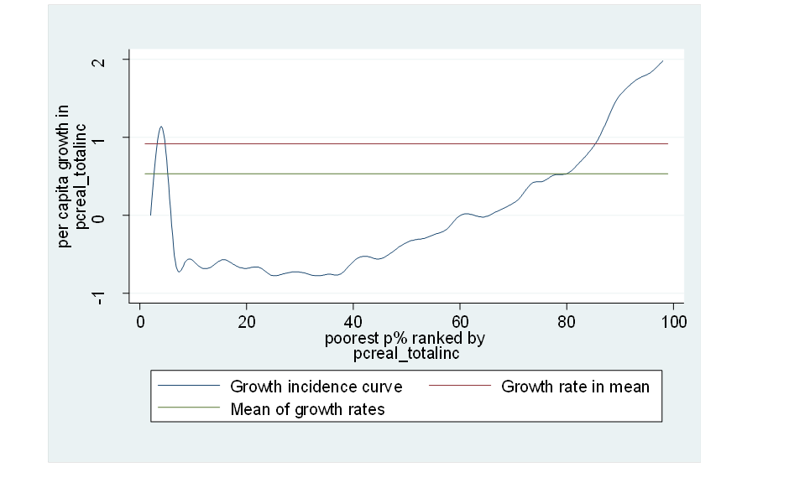
Second-Order Outcomes: Unequal Growth
Income Inequality With and Without Grant Income:
Gini Coefficients, 1995 & 2010
Growth Incidence Curve, South Africa: 1995-2010
 | 1995 |  |  | 2010
 | With Grant | Without Grant | Diff. | With Grant | Without Grant | Diff.
 | By Race of HH Head
African | 0.587 | 0.633 | 0.046 | 0.645 | 0.734 | 0.089
Coloured | 0.489 | 0.527 | 0.038 | 0.588 | 0.632 | 0.044
Asian | 0.462 | 0.476 | 0.015 | 0.522 | 0.542 | 0.021
White | 0.446 | 0.452 | 0.006 | 0.469 | 0.476 | 0.007
 | By Gender of HH Head
Male | 0.641 | 0.661 | 0.020 | 0.667 | 0.703 | 0.035
Female | 0.647 | 0.708 | 0.061 | 0.679 | 0.782 | 0.103
Total | 0.663 | 0.690 | 0.028 | 0.696 | 0.749 | 0.053

Slide 11

The Rise of the Missing Middle: A New Form of Exclusion
Annual Average Growth Rate of Real Monthly Earnings in South Africa for the Period 2000-2015
Percentiles
1_{p}-34_{p}
4.4 million
(34.1%)
35_{p}-69_{p}
4.7 m
(36.4%)
70_{p}-84_{p}
2m
(15.5%)
85_{p} – 100_{p}
1.8m
(14%)
No. of people in percentile range
Source: Post-apartheid Labour Market Series (PALMS)
Notes: adjusted using sampling weights; sample consists of all employed adults of working age with non-missing wage and hours of work data.

Slide 12
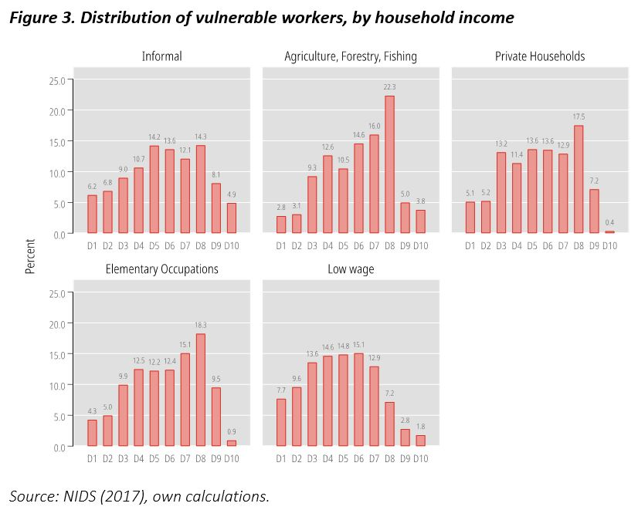
Using Research for Policy Impact:
The Covid-19 SRD Grant
Distribution of Vulnerable Workers, By household Income Decile: 2017
Initial impetus from activists was for social grants only to be used as instrument for Covid-19 support package.
  Data indicated that many vulnerable households affected by Covid-19 (informal sector, SMEs) would not be reached if only grants used as mechanism for support.
Evidence Used was based on above missing middle work and distributional illustration of labour market categories.
Outcome was the introduction of a COVID-19 Social Relief of Distress (SRD) grant, set at R350 per month. Targeted specifically at:
  Individuals above the age of 18, unemployed, and neither receiving any income nor any other social grant or support from the UIF.
Evidence shows that on average about 3.4 million grants were disbursed = 0.78 grants per (narrowly) unemployed individual in South Africa.
Source: NIDS (2017), own calculations.

Slide 13
The Next Research-Policy Frontier:
Inequality and Joblessness
Wage income contribution to inequality broken into two components.
  Unemployed, classified as ‘zero earners’.
  Wage Differences between employed.
South Africa is most unequal society in the world, but also has one of the highest unemployment rates in the world. High unemployment levels critical in driving overall income inequality in South Africa.
Wage inequality is driven by:
  Number or share of workers unemployed (‘zero earners’) and
  Differences in wages between those already employed.
Evidence suggests significant share of contribution of wage inequality to overall income inequality is due to individuals not having a job – namely being unemployed.
  Driver of inequality is not only wage differences, but also not having a wage and thus being unemployed.
Gini decomposition results (Leibbrandt et al; 2012): About 38% of wage inequality in South Africa is a function of individuals not having a job. The notion that national inequality is everywhere and always a function of wage differences only is thus empirically and factually incorrect.
High unemployment in South Africa is a key shaper and determinant of the country’s overall inequality.

Slide 14

POST-SCRIPT:
A University Of Cape Town-Cornell University Innovation:
Minimum Wage Violation And Partial Compliance
ECONOMETRIC WORK ON MINIMUM WAGE BEGINS
- Apply two variants of DiD strategies to examine impact of MW law in agriculture (published in AJAE, 2014)
MULTIPLE VIOLATION WORK
- Create original index to measure wage & non-wage violation, with application to SA (forthcoming).
- Extend work on compliance (IZA, 2019)
EXTENDING MW WORK
- DiD approach extended to 5 sectors (JoLD, 2013)
PARTIAL COMPLIANCE
- Introduce new theory & application for ‘partial compliance’ with MW laws, using V^{α}
(JoLD, 2014)
2011/12
2014
2015
2018/19
2016/17
Vα Applications in 24 Countries Around the World:
Chile, Ecuador, Honduras
Namibia, Kenya, Tanzania, Zambia, Mauritius, Comoros, Seychelles
Czech Republic, Italy, Hungary, Poland, Lithuania, Slovakia, Slovenia, Estonia, Bulgaria, Romania, Latvia
China, India, Jordan
MEASURING VIOLATION
- First paper measuring MW violation (ILR, 2012)
- First paper examining relationship btw enforcement & compliance (RDE, 2012)
2013
DEVELOPING COUNTRY CONTEXT
- Begin work on MWs, enforcement, and compliance in a developing country context (IZA, 2014)
INTRODUCING V^{α}
- Develop novel index to measure extent & depth of MW violation (Labour, 2013)
- Index now applied globally:
BROADENING MW WORK
- Apply DiD techniques to young workers (JAE, 2016)
- Extend scope of work to countries in SSA, apply V^{α}
(WBRO, 2017)

Slide 15
Impact of Science
23-25 June, 2021
Erika Kraemer-Mbula
Professor of Economics at University of Johannesburg, South Africa
#IOS21

Slide 16

AESIS 2021 Virtual Conference
Impact of Science
23rd June 2021
How can science be utilised for all of society and thereby close existing gaps of inequality?
Prof. Erika Kraemer-Mbula
DST/NRF/Newton Fund Trilateral Research Chair in Transformative Innovation, the 4th Industrial
Revolution and Sustainable Development
University of Johannesburg, South Africa
erikakm@uj.ac.za

Slide 17

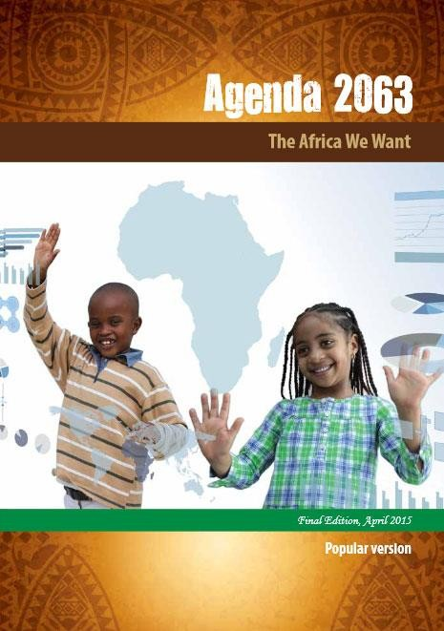



Agendas guiding Africa’s aspirations for ST&I-driven transformation
STISA 2024
African Union: Agenda 2063
UN: SDGs
2

Slide 18
2019 White Paper on Science, Technology and Innovation, South Africa
“As Africans, we share a common history and, as humankind, a common future”
MINISTER OF SCIENCE AND TECHNOLOGY
3

Slide 19
Ongoing “tensions” in (South) African research
GLOBAL EXCELLENCE
(South) African researchers are ranked on the basis of their ability to publish internationally in high impact peer-reviewed journals,
LOCAL RELEVANCE
Increasing pressure to be locally relevant -- conducting locally relevant research that deals with (South)
African socioeconomic problems.
4

Slide 20

This book takes a critical view on conceptual issues and practical problems that inevitably emerge when ‘excellence’ is at the centre of science systems.
The book contains insights and recommendations that point towards new solutions – both for the Global South and the Global North.
Free copies downloadable from : www.africanminds.co.za/dd- product/transforming-research-excellence- new-ideas-from-the-global-south/
5

Slide 21
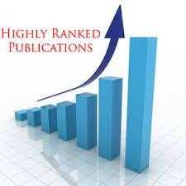

Excellence in the process and excellence in the outputs
6

Slide 22
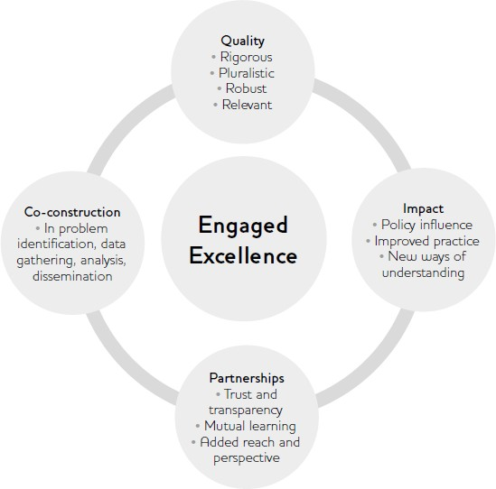
“Engaged excellence”
High-quality research needs to be engaged
with society, not detached from it
Four inter-dependent pillars
Quality linked to Rigorous and Robust
research but also Plurality and Relevance
Be based on the co-construction of
knowledge
Needs to mobilise impact-oriented
evidence
Be based on enduring partnerships
Source: Leach et al (2016)
7

Slide 23



The Sabato Triangle (1968): describes a structural bond between scientific knowledge and development
The strength of the sides of the triangle (the interrelationships among actors) are more important than the strength of the vertices
There are three types of relationships in the triangle, each entailing specific and changing power relations:
  Intra relations within each vertex
  Inter relations between the vertices
  Extra relations for each vertex
Government/
Society
Research
system
Productive sector
(application/innovation)
8
Source: Sutz (2020)

Slide 24
Research systems in developing countries tend to be come connected to international research systems than to their domestic realities
Research systems in developing countries
Relying on internationally “validated”
research problems and research programs
Externally driven evaluation criteria (what means being a good researcher or having a good proposal)
Internationally driven research
methodologies
Source: Prof. Judith Sutz in
Kraemer-Mbula et al (2020)
9

Slide 25
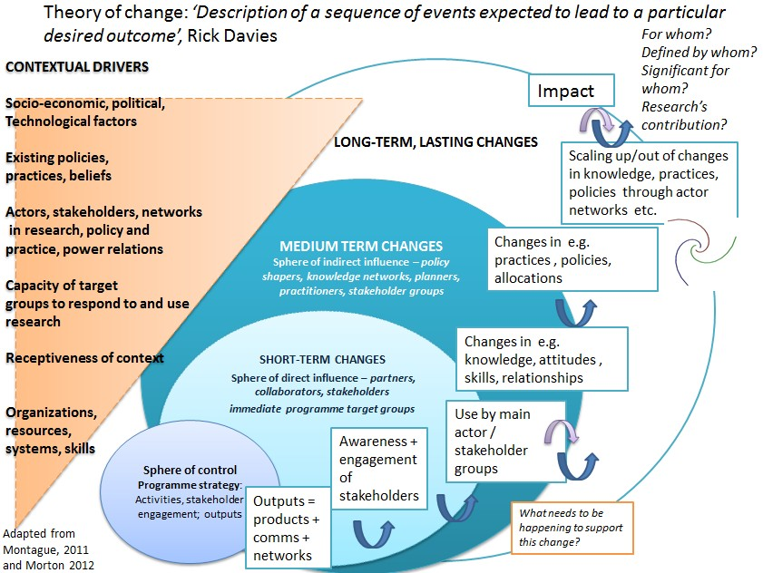
Embedding impact into the research process
10

Slide 26
Indicators perceived as overlooked in mainstream research evaluation
Researchers and research coordinators
Social and economic impact
Local relevance
Policy influence
Impact across disciplines
User uptake
Mentorship and promotion of young researchers
Innovation – commercialisation of research outputs
Gender equity
Ethical compliance
Alignment with national development priorities
Source: Tijssen and Kraemer-Mbula (2017)
11

Slide 27
Revisiting modalities of research evaluation
How can evaluation criteria reflect values that are relevant to emerging
economies?
Develop research assessment frameworks that takes into consideration criteria relevant for the local/regional context/global developmental priorities?
  Beyond immediate outputs to broader outcomes and impacts
  Multiple dimensions of research quality: participation, accessibility,
inclusiveness, gender, relevance, unintended negative impacts, etc
12

Slide 28
Thank you
erikakm@uj.ac.za
13

Slide 29
Impact of Science
23-25 June, 2021
Thank you
#IOS21

